Slide 1

DSA1080:GROUP 4 PROJECT
MEMBERS:
Harina Chohan 66983
Hermela Seltanu 670446
Omondi, Jacob Aboge - 670165
Nekesa Suzanne 670665
Chad Mutinda 664884
Ester Wambui 669399

Slide 2
INTRODUCTION

Slide 3
PARAMETERS AND CITIES
PM10
PM2.5
NO2
O3
CO
SO2
Augsburg, Germany
Aarschot, Belgium
San Boraj, Peru
Nairobi, Kenya
Geelong, Australia
Traralgon, Australia

Slide 4

AQI
The Air Quality Index (AQI) is a measure used to report daily air quality and indicates how clean or polluted the air is.
It provides information on the level of air pollution and the associated health effects, with values ranging from 0 to 500.
Higher AQI values correspond to higher levels of pollution and greater health concerns

Slide 5
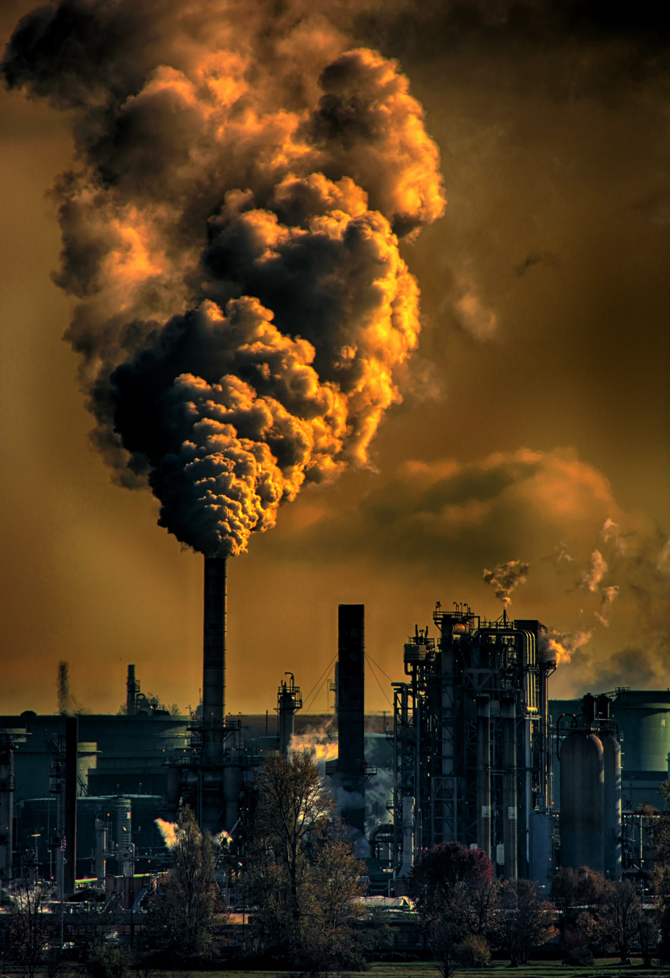
ABOUT THE POLLUTANTS:
PM stands for particulate matter, it is extremely small solid particles and liquid droplets in the air.
PM10 - particles that have a diameter of 10 micrometers or less. They are small enough to pass through the throat and nose and enter the lungs.
PM2.5 - particles with a diameter of 2.5 micrometers or less. Particles are small enough to get deep into the lungs and enter the bloodstream.
O₃ or Ozone is good up high, but bad nearby. At ground level breathing it in can cause serious health problems as it can aggressively react chemically with lung tissues.
NO₂ or Nitrogen Dioxide is known as a primary pollutant, it causes respiratory problems when inhaled and environmentally can cause acid rain.

Slide 6

PROJECT OBJECTIVES
Gaining insights
Understanding and interpreting trends
Insights on the variability and stability of the data. Understanding reasonings for variability and/or stability.
Taking the visual data and interpreting the trends that occur. Understanding the events that may have taken place for the trend to be.
Visualization of the data
Comparisons of different cities
Showing the data in a visual form for easy understanding and interpretation. Also, trends can be visualised and explained easier through graphs.
Every city has different levels of an AQI rating and pollution levels.
Notes:
© Copyright PresentationGO.com – Free Templates & Infographics for PowerPoint and Google Slides

Slide 7
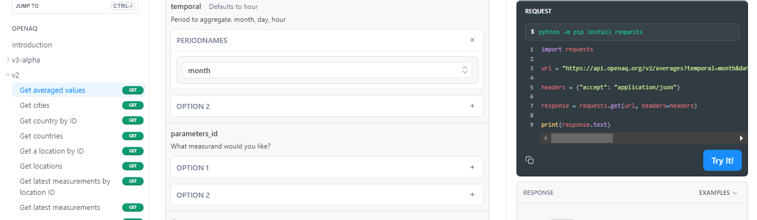
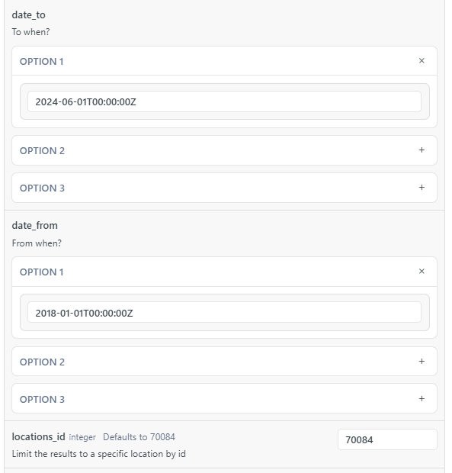
HOW WE GOT OUR DATA

Slide 8
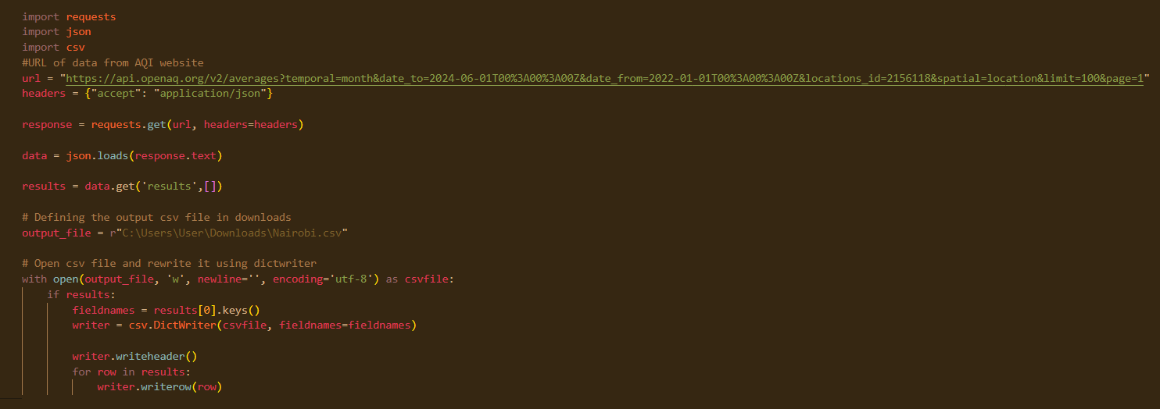
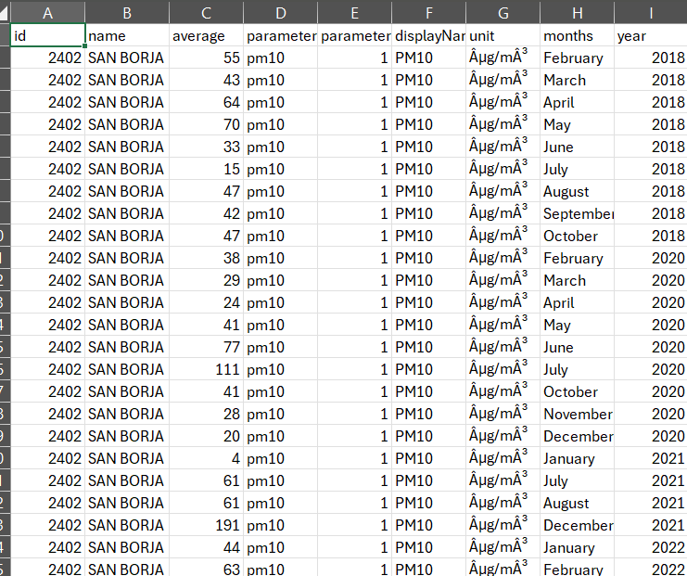
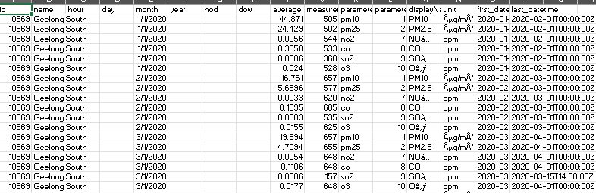
We downloaded the data into a csv file through:
Our CSV files:

Slide 9
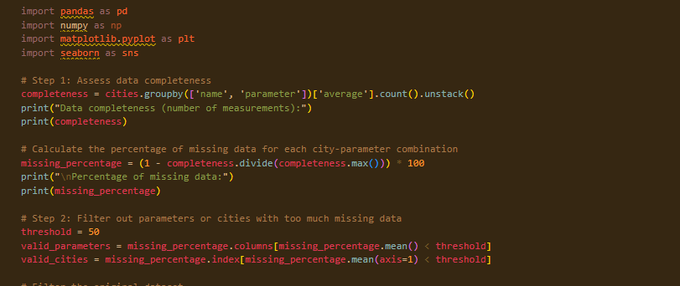
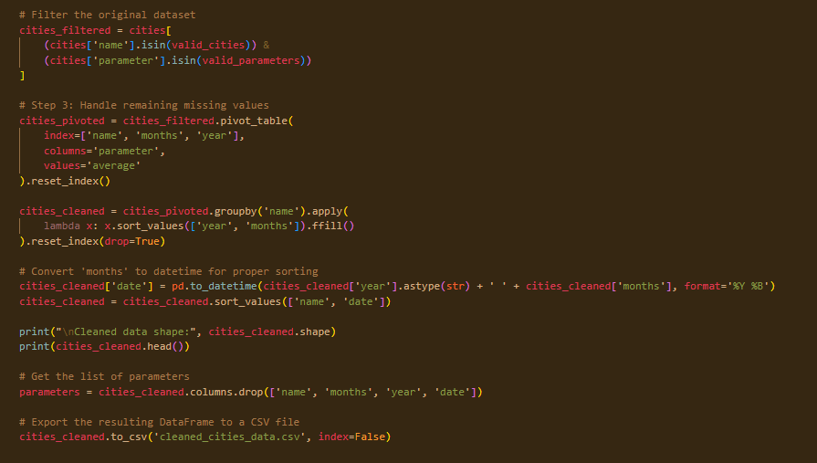
CLEANING THE DATA
Step 1 for cleaning the data includes:
Assessing the completeness of the data
Calculating percentage of missing data
Filtering out parameters or cities with a lot of missing data
Next step:
Filtering the dataset
Handling the missing values
Conversion of ‘months’ to datetime
Getting list of parameters
Exporting the resulted cleaned dataframe into a csv file.

Slide 10
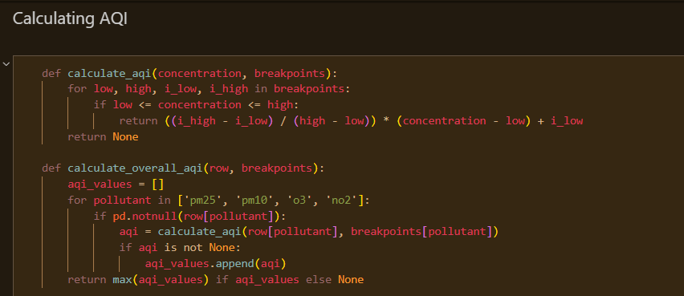
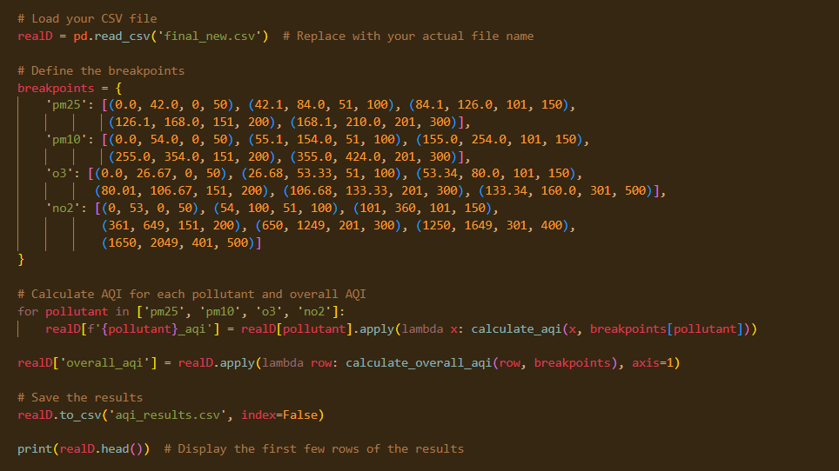
AQI CODES AND CALCULATIONS
Function to calculate AQI for each city
Calculation of AQI values for each pollutant
Creating a csv file with these results.

Slide 11
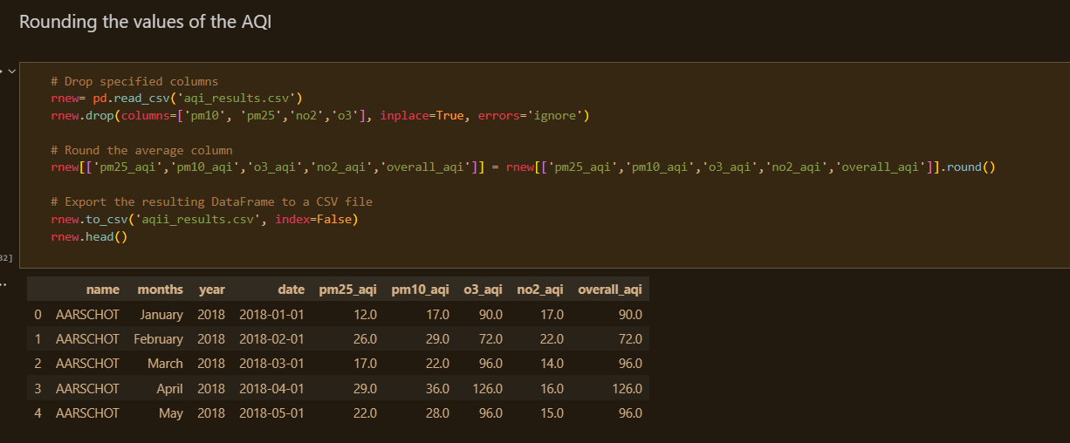
Rounding AQI values
Data from january to may of 2018 from Aarschot, Belgium

Slide 12
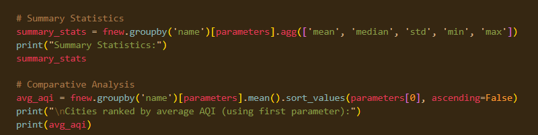
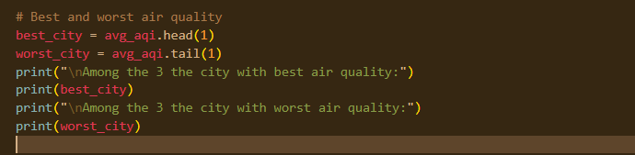
Summary statistics and comparative analysis
Output of cities with best and worst air quality according to AQI values calculated

Slide 13
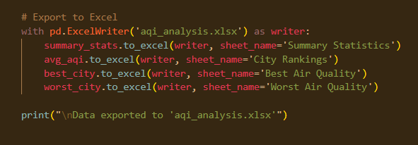
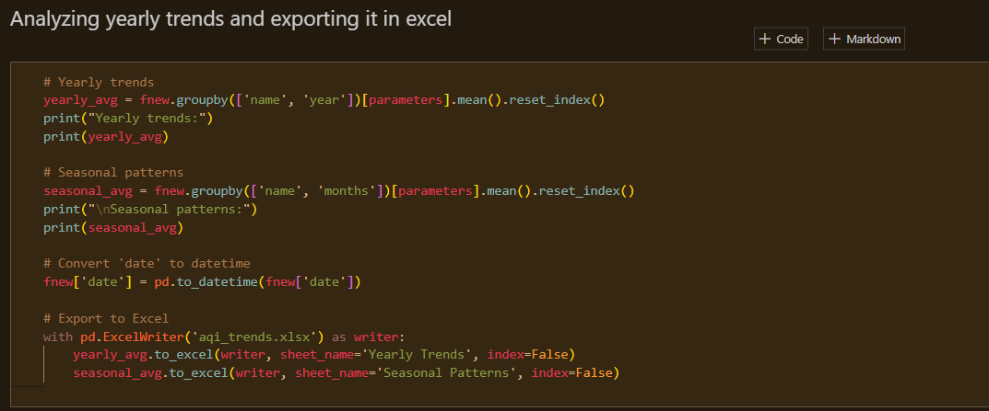
First code summarizes the data via:
Average AQI score for each city and parameter
Overall AQI score for each city
Calculates the city with the best air quality
Calculates the city with the worst air quality
Exports this data into an Excel file
The second code summarizes the AQI data via:
Giving the average AQI value for every year of each city and every parameter
Exports the calculations into the Excel file.
AQI summary data exported to Excel
Database created shown on the right:

Slide 14
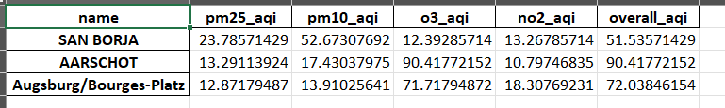
General summary statistics:
Overall AQI score:
Best air quality:
Worst air quality:

Slide 15
AQI VISUALISATION

Slide 16
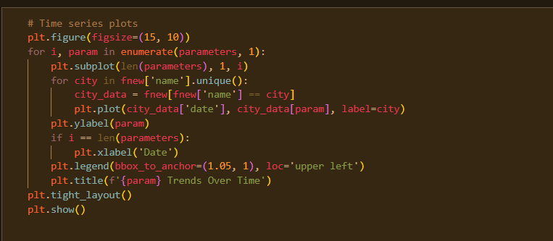
Our code for the line charts (to follow)
Shows the trends over time for each parameter
Visualises the data from 2018 to 2024
Shows differences in AQI between the 3 cities

Slide 17
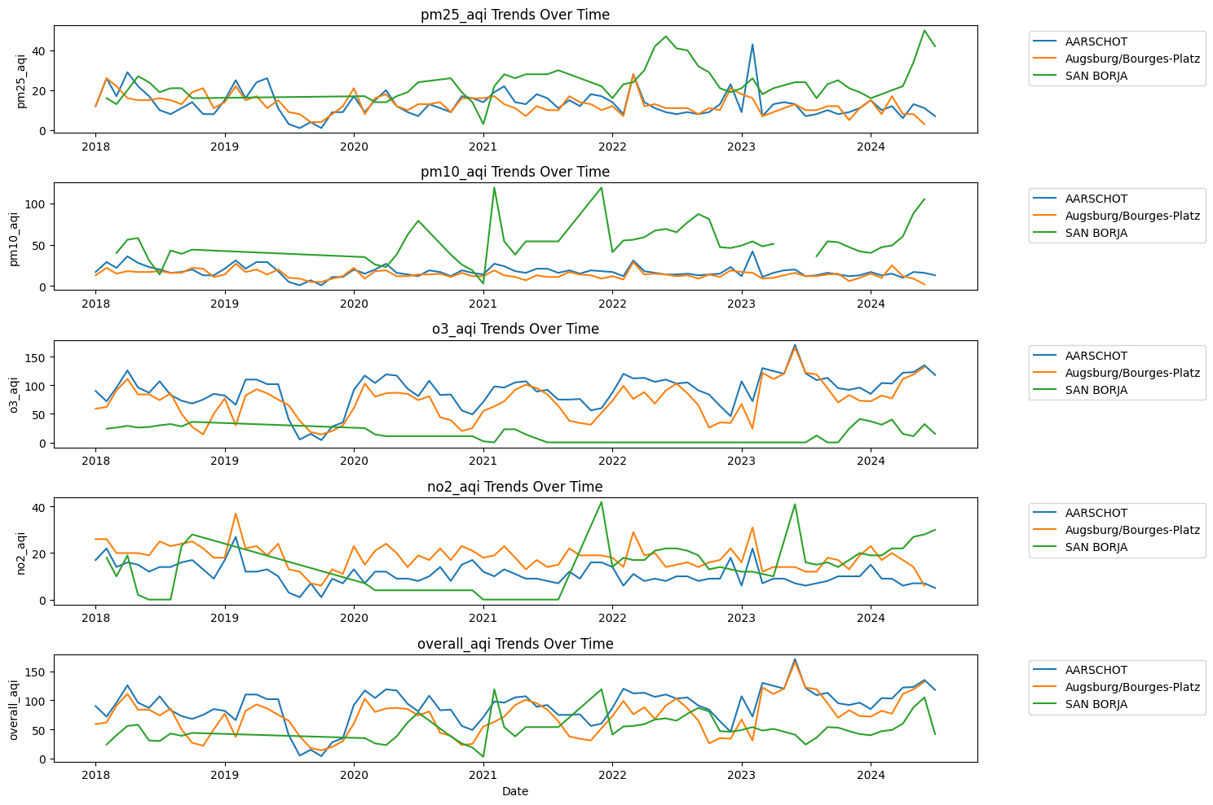
It seems like a dip in the graph around 2020 for all 3 countries and the parameters.
This could be due to COVID times starting around that time and people had to stay home.
Aarschot was generally the most polluted city out of the 3.

Slide 18
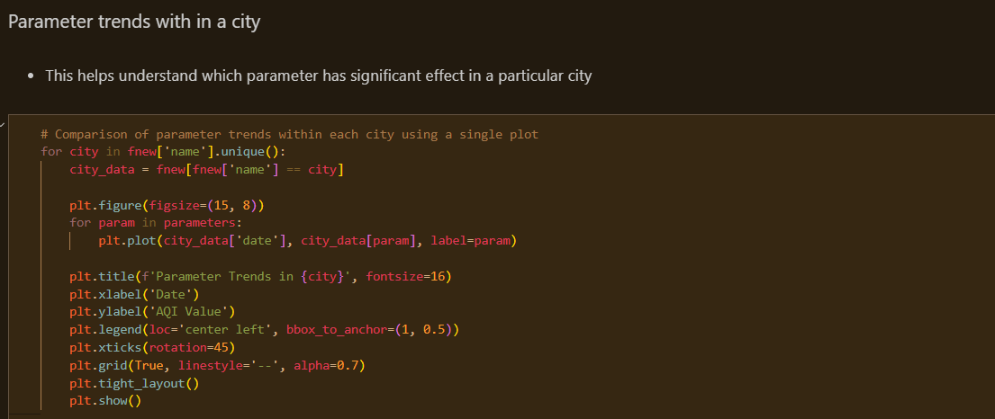
Code for visualisation

Slide 19
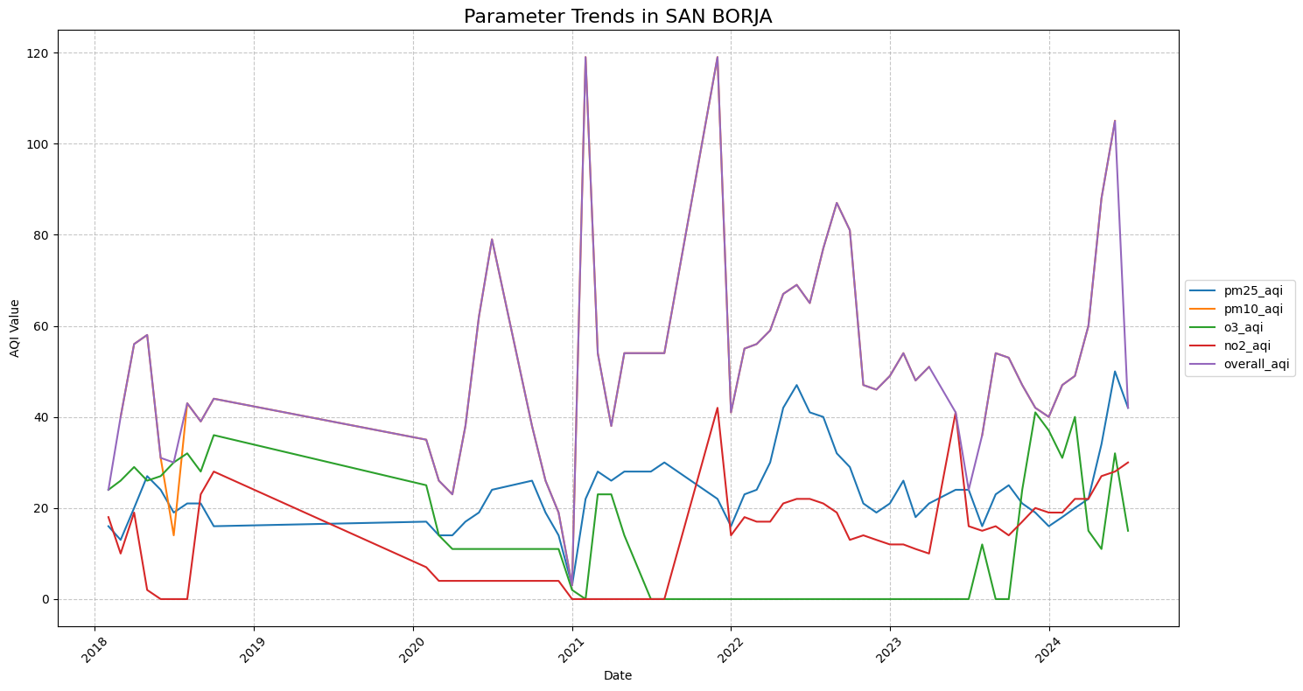
City 1: San Borja, Peru
Trends in San Borja:
Parameter trends of NO2, O3, PM10, and PM2.5, and overall AQI
Between 2018 and 2024
Most variability seen in the overall AQI value
Data for PM10 was for a short time only.

Slide 20
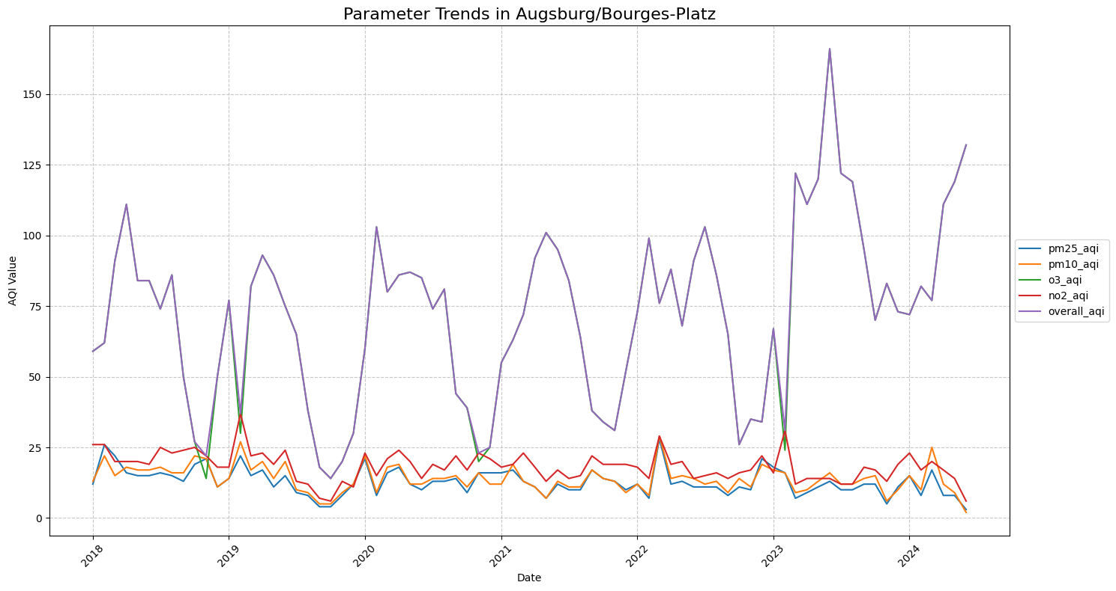
City 2: Augsburg, Germany
Trends in Augsburg:
Parameter trends of NO2, O3, PM10, and PM2.5, and overall AQI
Between 2018 and 2024
Most variability seen in the overall AQI value
Other data is fairly constant and parameter AQI values are similar

Slide 21
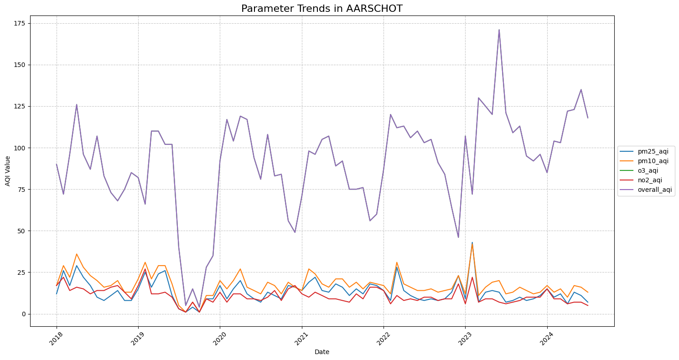
City 3: Aarschot, Belgium
Trends in Aarschot:
Parameter trends of NO2, O3, PM10, and PM2.5, and overall AQI
Between 2018 and 2024
Most variability seen in the overall AQI value
Graph is very similar to that of Augsburg

Slide 22
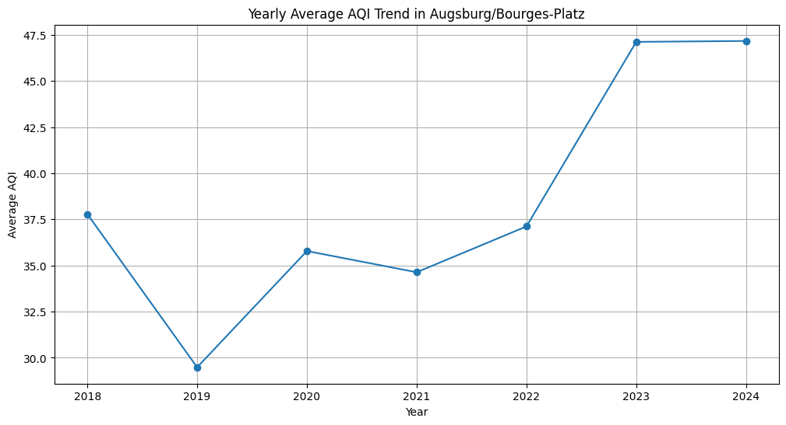
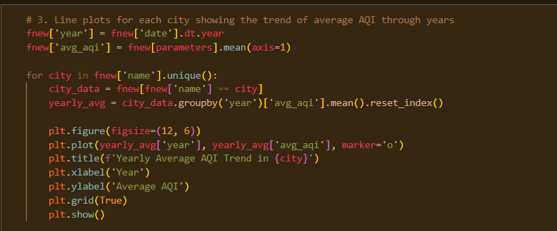
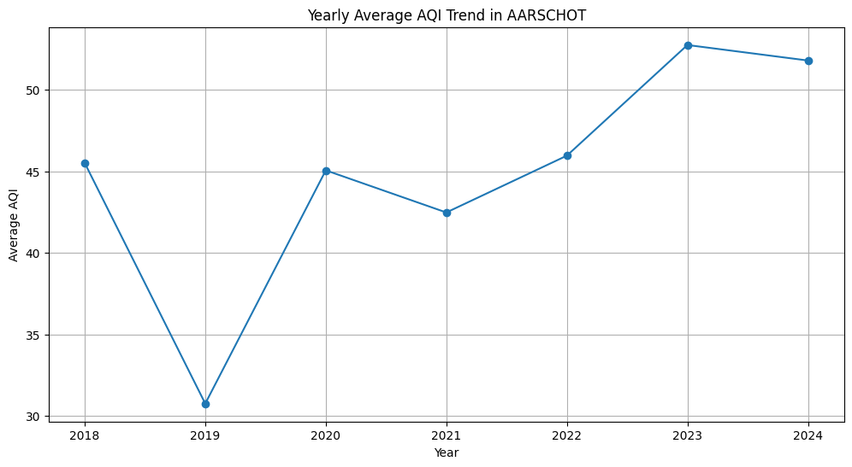
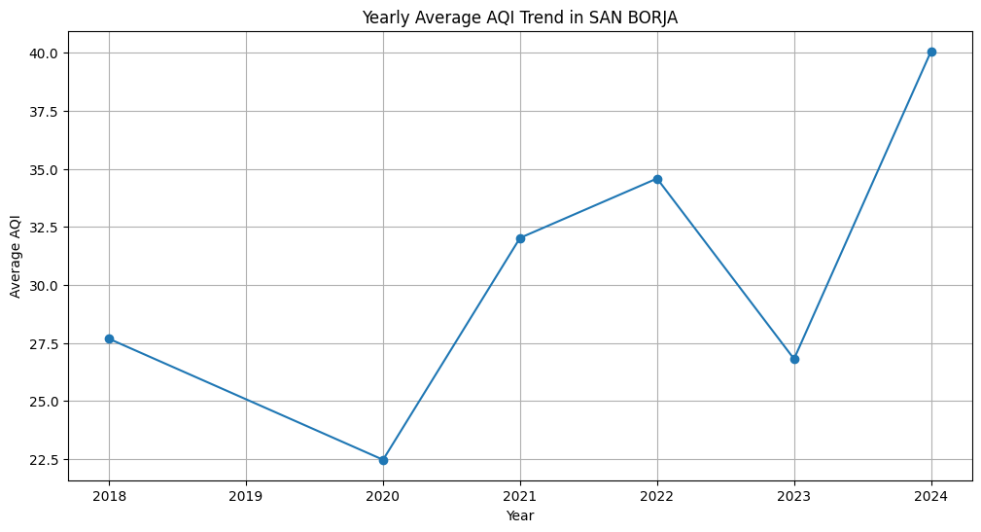
Line plots for yearly average AQI:

Slide 23
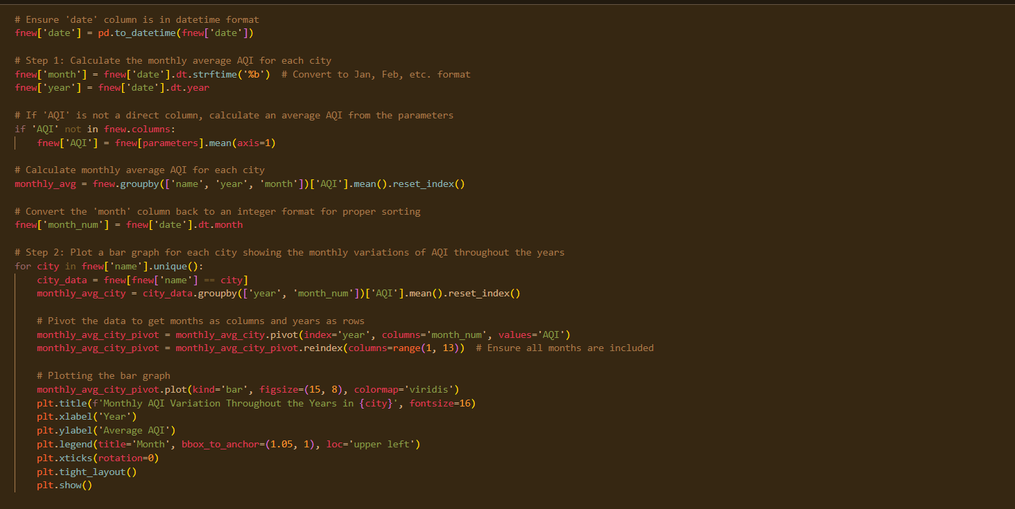
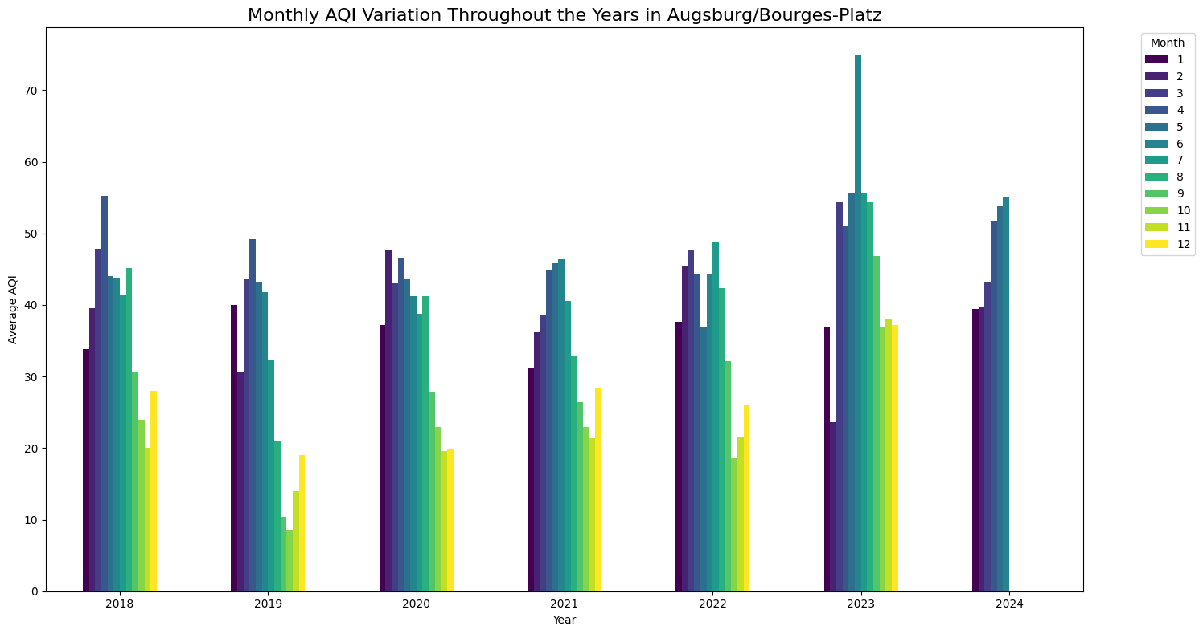
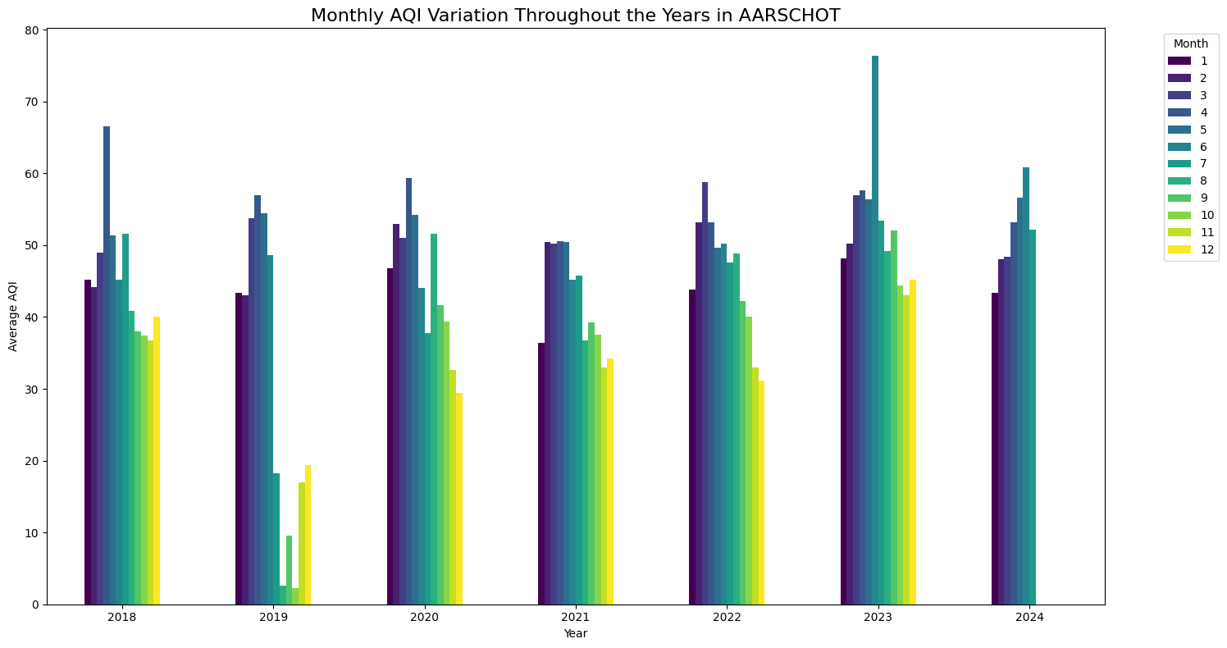
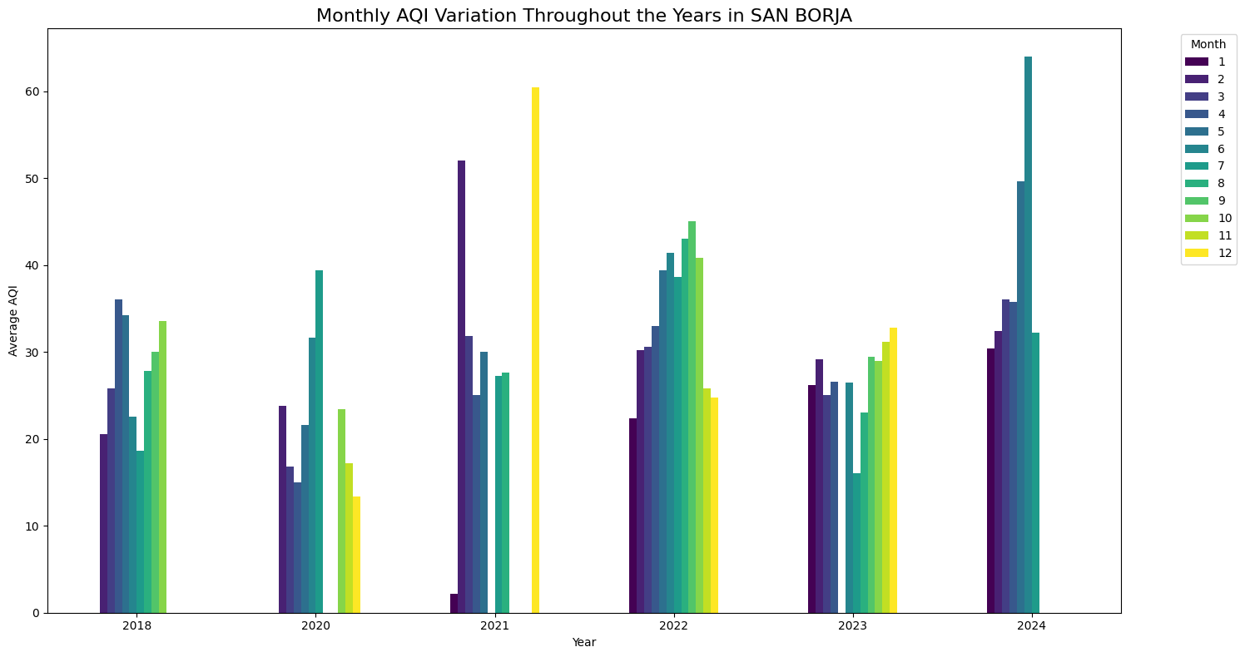
Monthly AQI variation throughout the years:
From 2018 till 2024
In Aarschot, 2018 and 2023 had the most noticeable variations
For Augsburg, the most noticeable variation is 2023
The graph for San Borja shows the amount of missing values especially in 2020 and 2021.

Slide 24
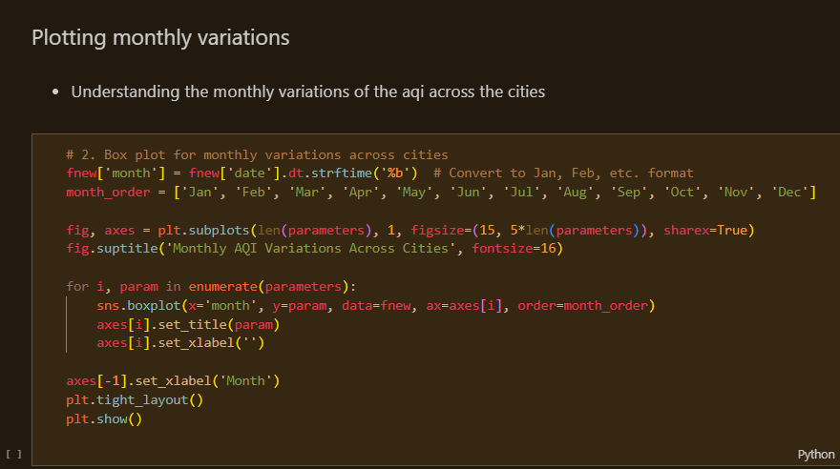
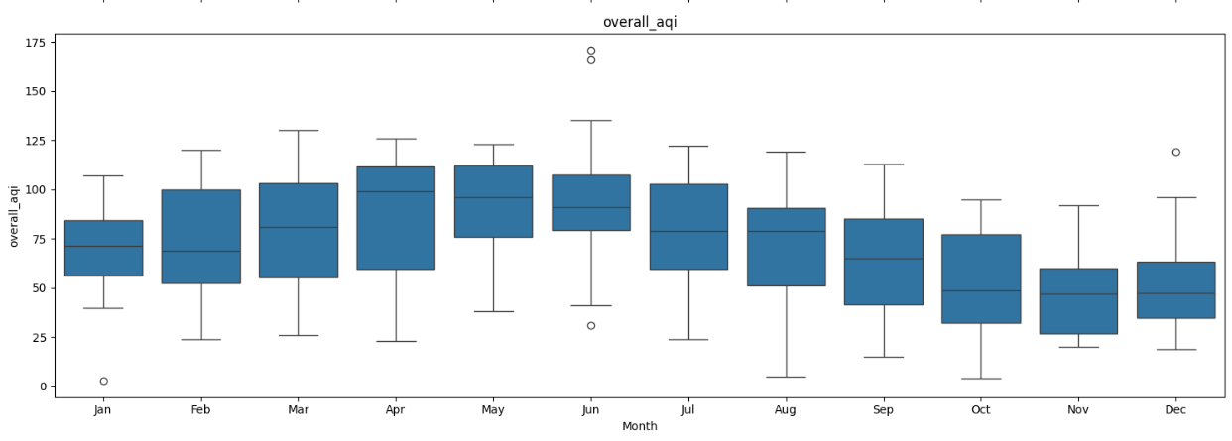
Plotting a box and whisker plot diagram for the monthly average of AQI across the cities
Average of the month across the years.
Largest variation is in June.
Smallest variation seems to be January
Box and whisker diagram
Line in the middle = median point
Lines outside = maximum and minimum value
Shows variance in data

Slide 25
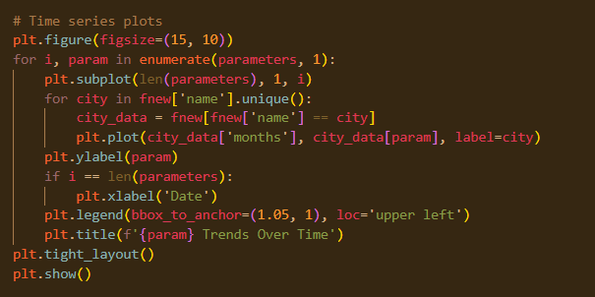
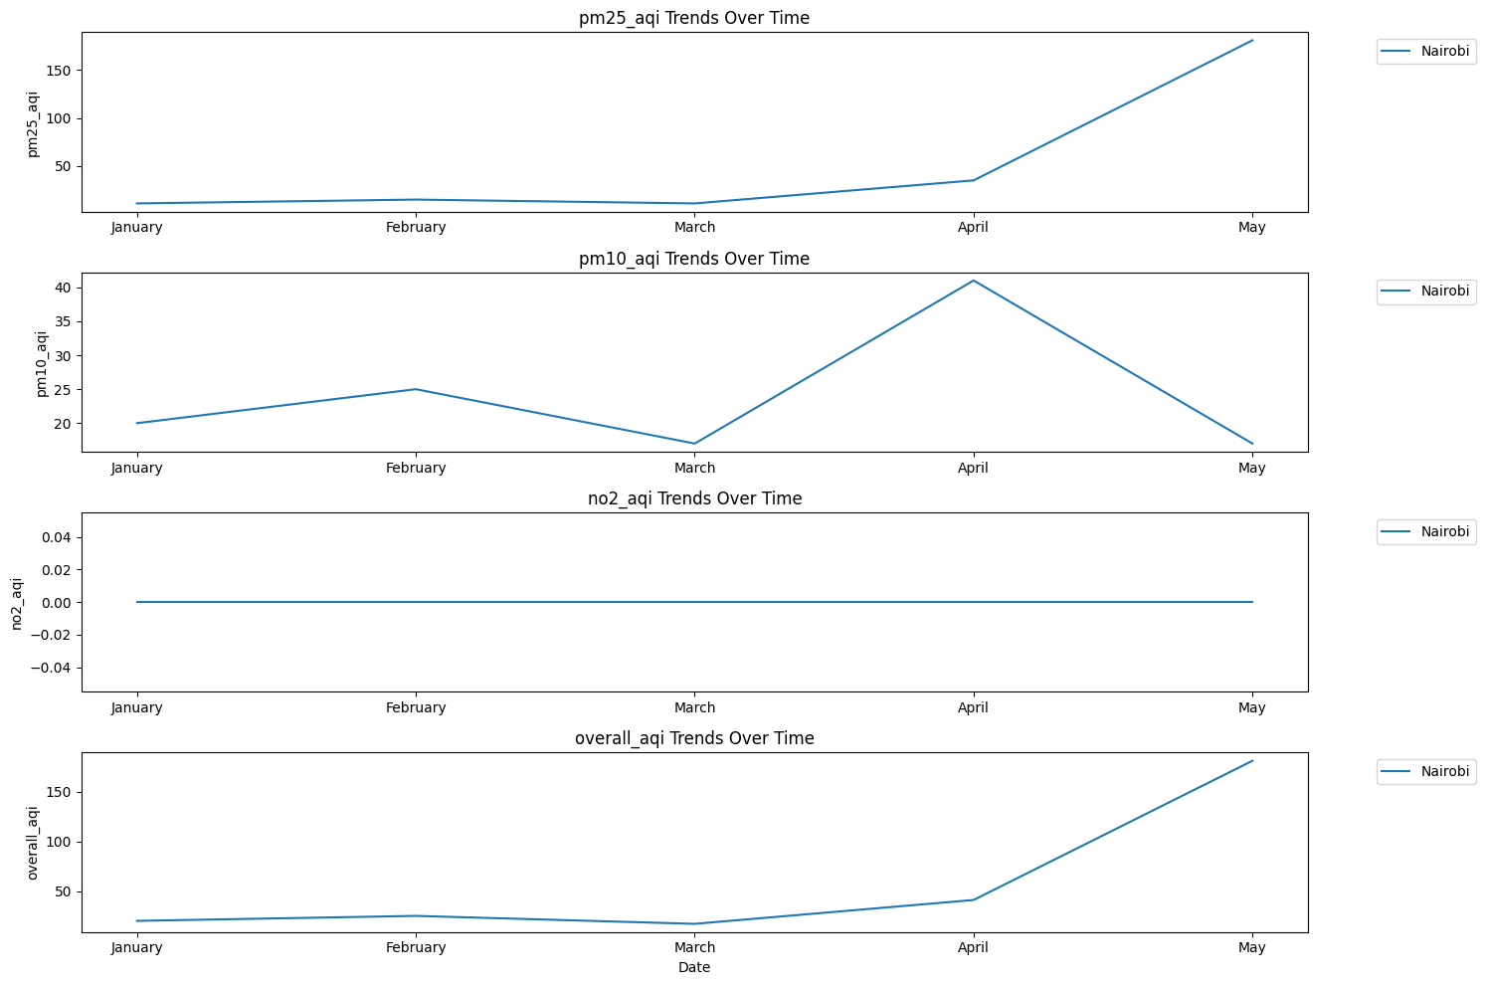
NAIROBI AQI TRENDS OVER TIME
In April 2024, Nairobi hosted a variety of events including parties, concerts, seminars, expos, and festivals.
African Music Legends Tribute Series 2024.
Bizarre Bazaar Festival April 2024 Edition.
Ingwe @ 60
KidsCon 2024
Nairobi Colour Festival
Nairobi International Choral Festival.

Slide 26
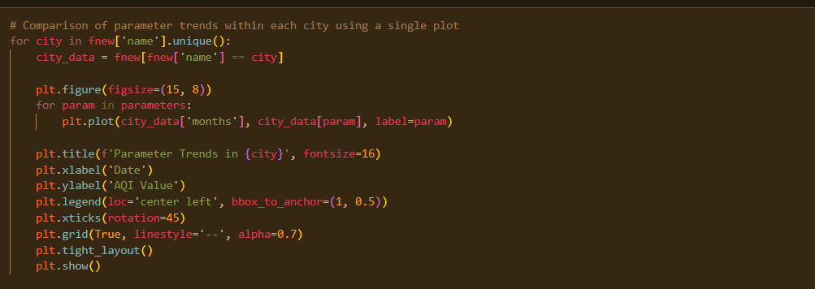
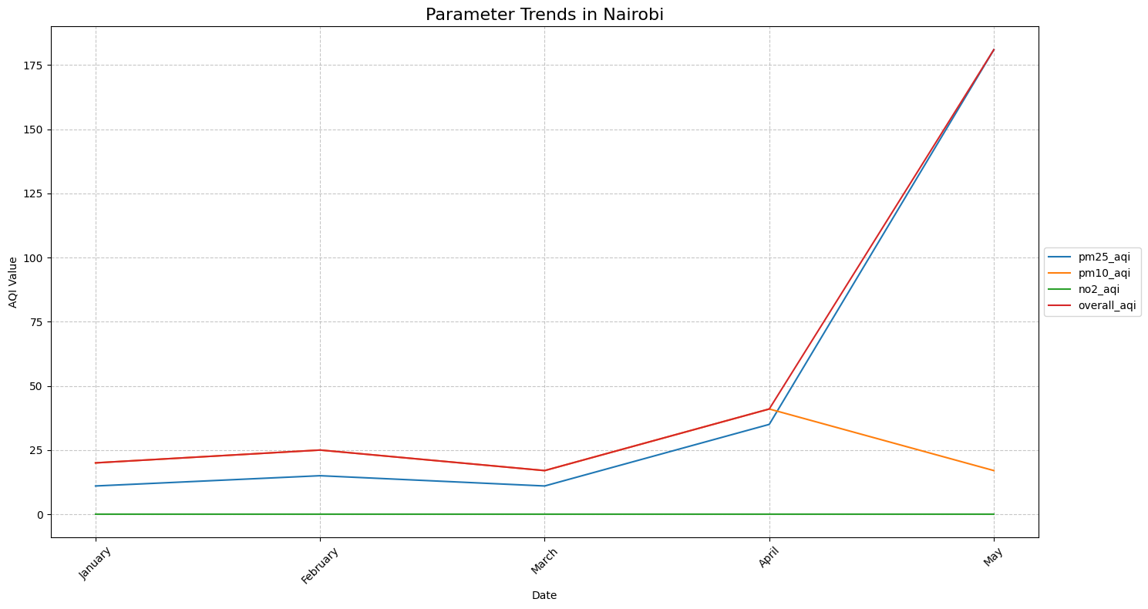
Parameter trends in Nairobi:
Helps in understanding which parameter has a significant effect on the air quality of Nairobi.
Parameter trends in Nairobi:
NO2 stays constant throughout the months
Overall AQI and PM2.5 seem to be increasing at the same rate
Interestingly, PM10 AQI reduces in April but that does not affect the overall AQI.
Conclusion, PM2.5 affected AQI the most.

Slide 27
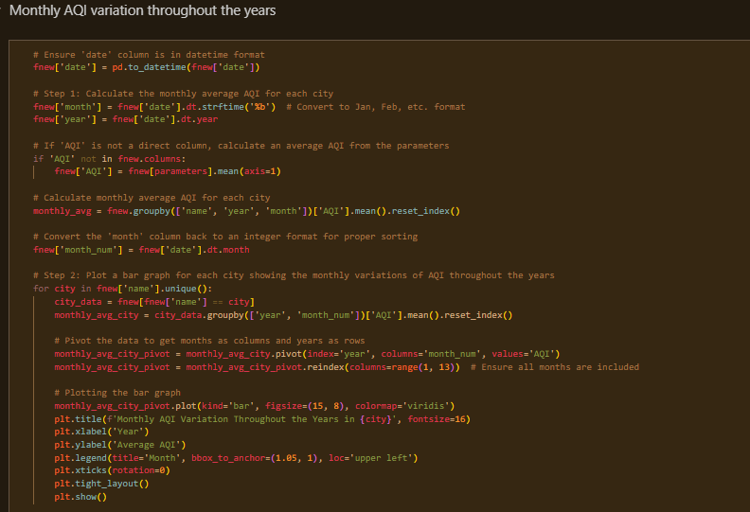
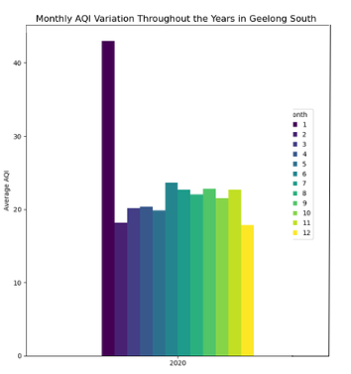
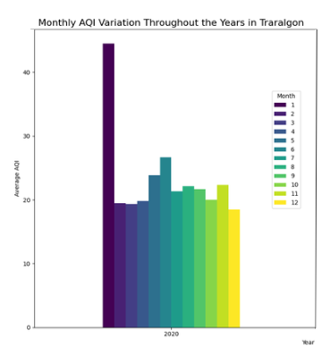
Monthly AQI variation
Throughout the year 2020
Cities:
Geelong South, Australia
Traralgon, Australia
Apart from January 2020, both cities have a pretty stable average AQI.
In January 2020, Geelong, Australia experienced variable weather conditions. There were days with temperatures ranging from a minimum of 10.1°C to a maximum of 24.9°C. The weather included incidents of smoke and light rain on several days. Notably, from January 4 to January 5, the area recorded smoke and light showers.
This could be the reason for the high AQI in January.
In January 2020, Traralgon hosted a tennis tournament which attracted junior players around the world.
Additionally, during the summer months, local community events and activities, such as outdoor festivals and sporting events, typically take place.

Slide 28
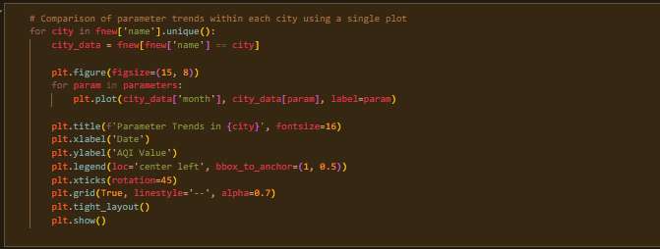
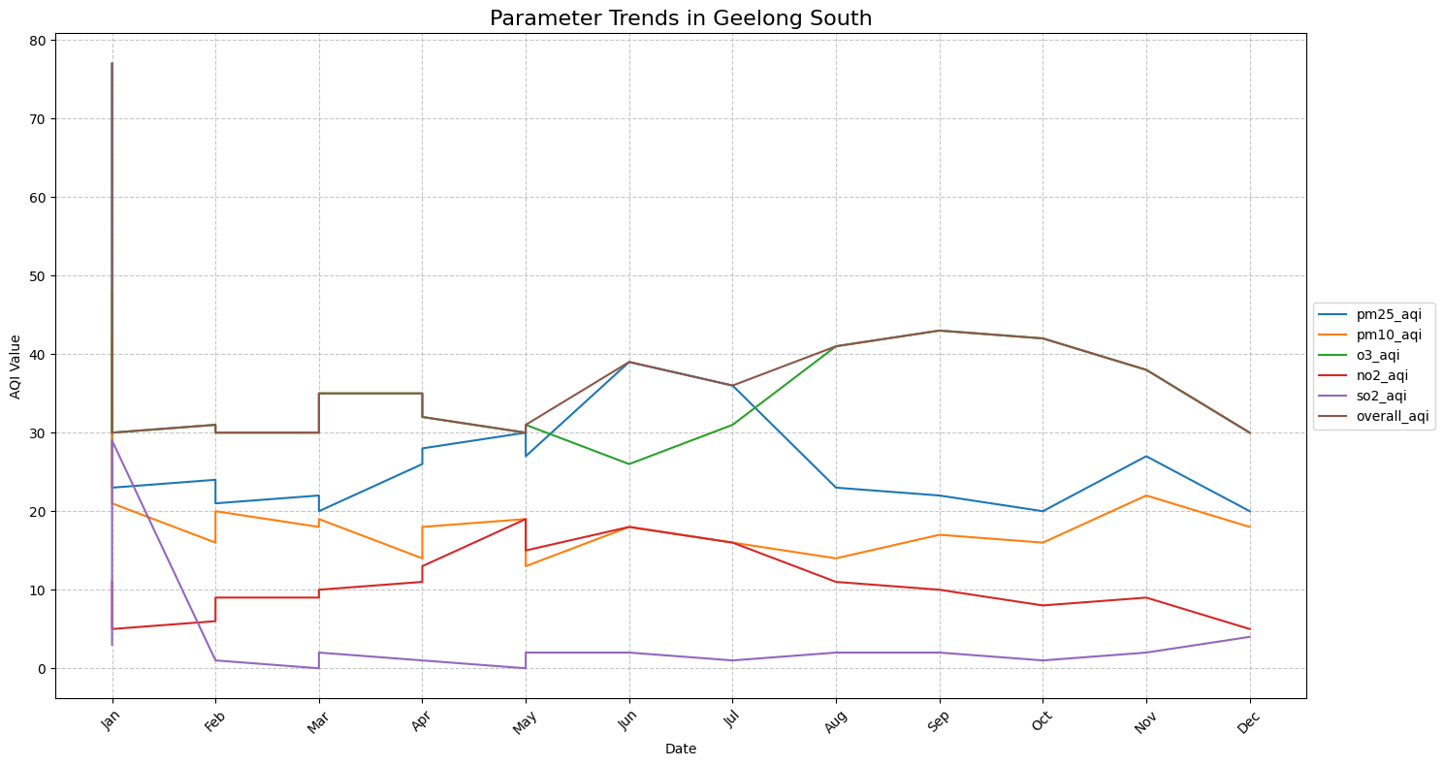
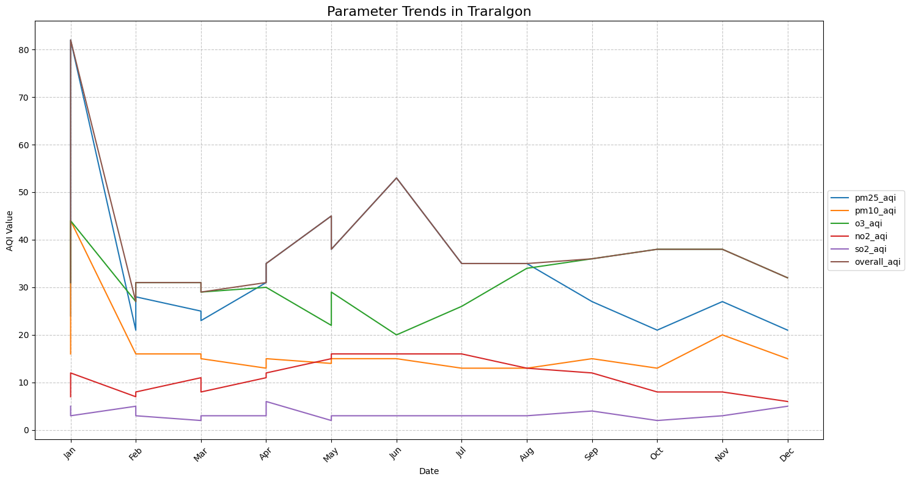
Parameter trends in Geelong South
Parameter trends in Traralgon
It helps understand which parameter has a significant effect on each city

Slide 29
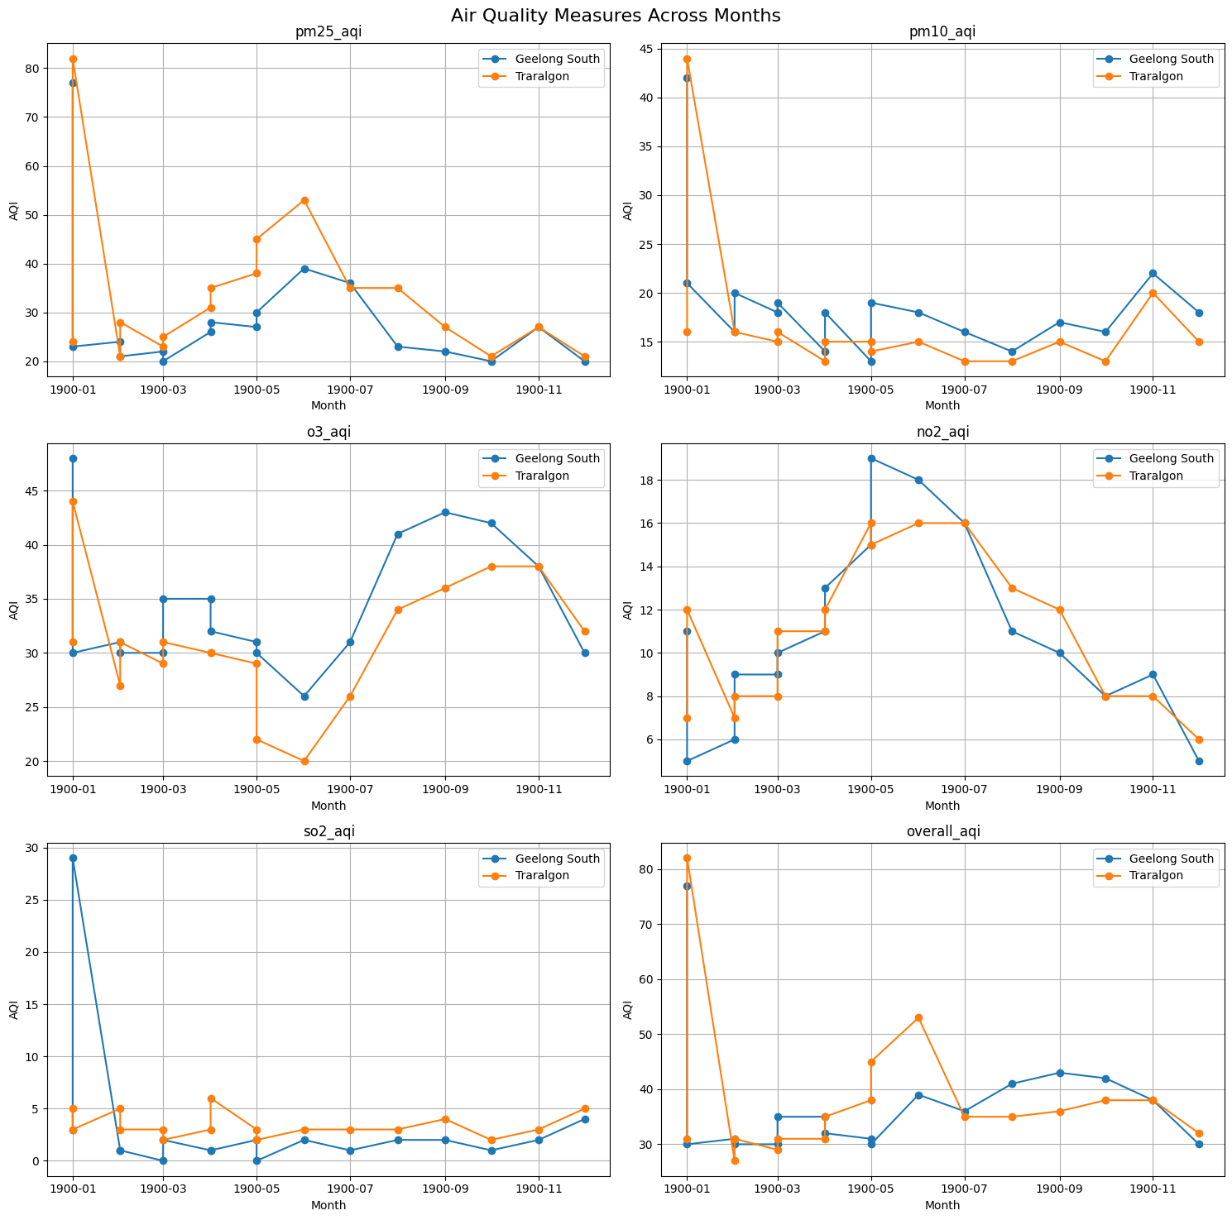
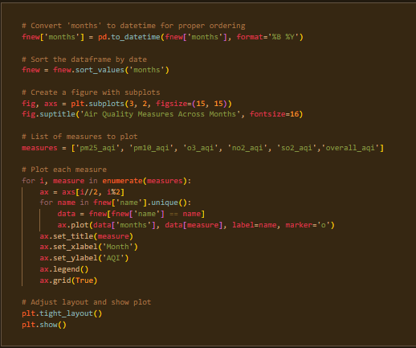
Geelong South compared to Traralgon
Line Graph

Slide 30
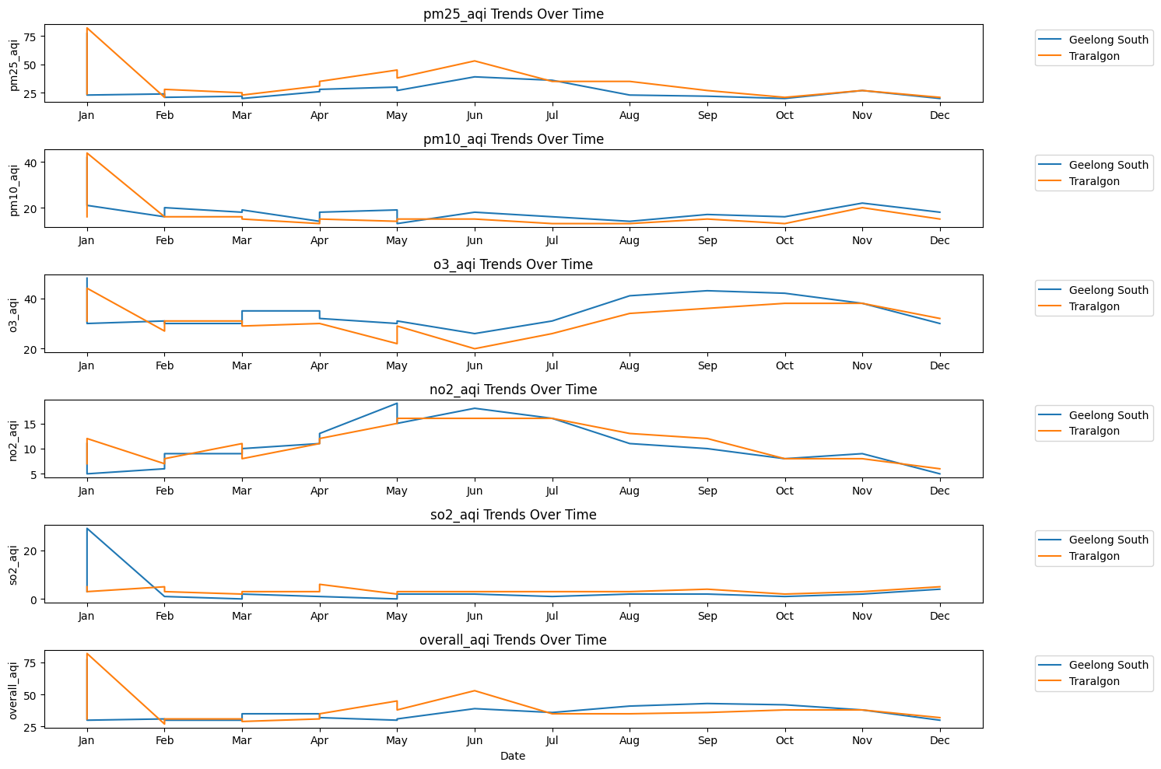
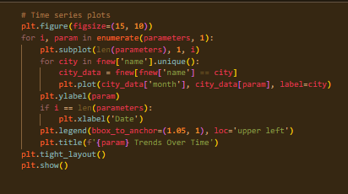
Time series plots
Comparisons
The trends for all 5 parameters are very similar for both Geelong and Traralgon.
The data was from 2020 January to December of the same year
Blue is Geelong and Orange is Traralgon.
Parameters available were: PMm2.5, PM10, O3, NO2, and SO2.
Last graph is the overall AQI value for the two cities.

Slide 31
RECOMMENDATION
As air quality is important we recommend every city to give more attention to it.

Slide 32
Limitations
Lack of adequate data
Environmental changes
Air quality changes due to various factors including weather patterns, pollution levels, and environmental conditions.
Air is constantly moving, making its quality susceptible to changes from day to day and even hour to hour.
Additionally, climate change can exacerbate air quality issues, as rising temperatures can increase pollutants in the atmosphere.
Finding cities that had data dating a couple of years was difficult, most had data from 2024 which is not enough for trend recognition.
There needs to be more data from African countries.
A lot of missing values and missing data.
We couldn't find enough data whether regarding to duration or parameters.

Slide 33
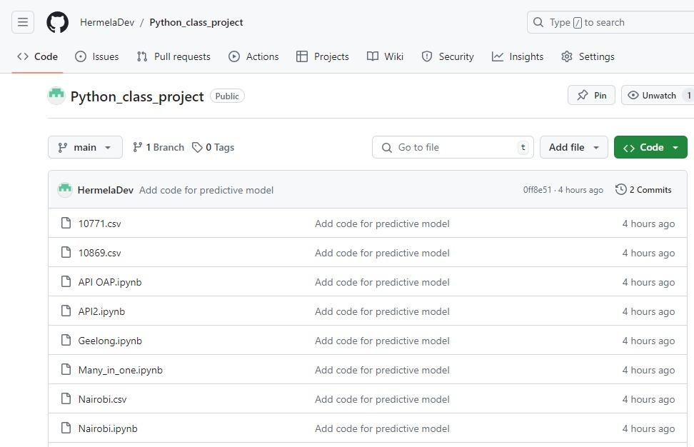
THANK YOU FOR LISTENING
Our GitHub page where we have posted the codes and the final project.

